Slide 1
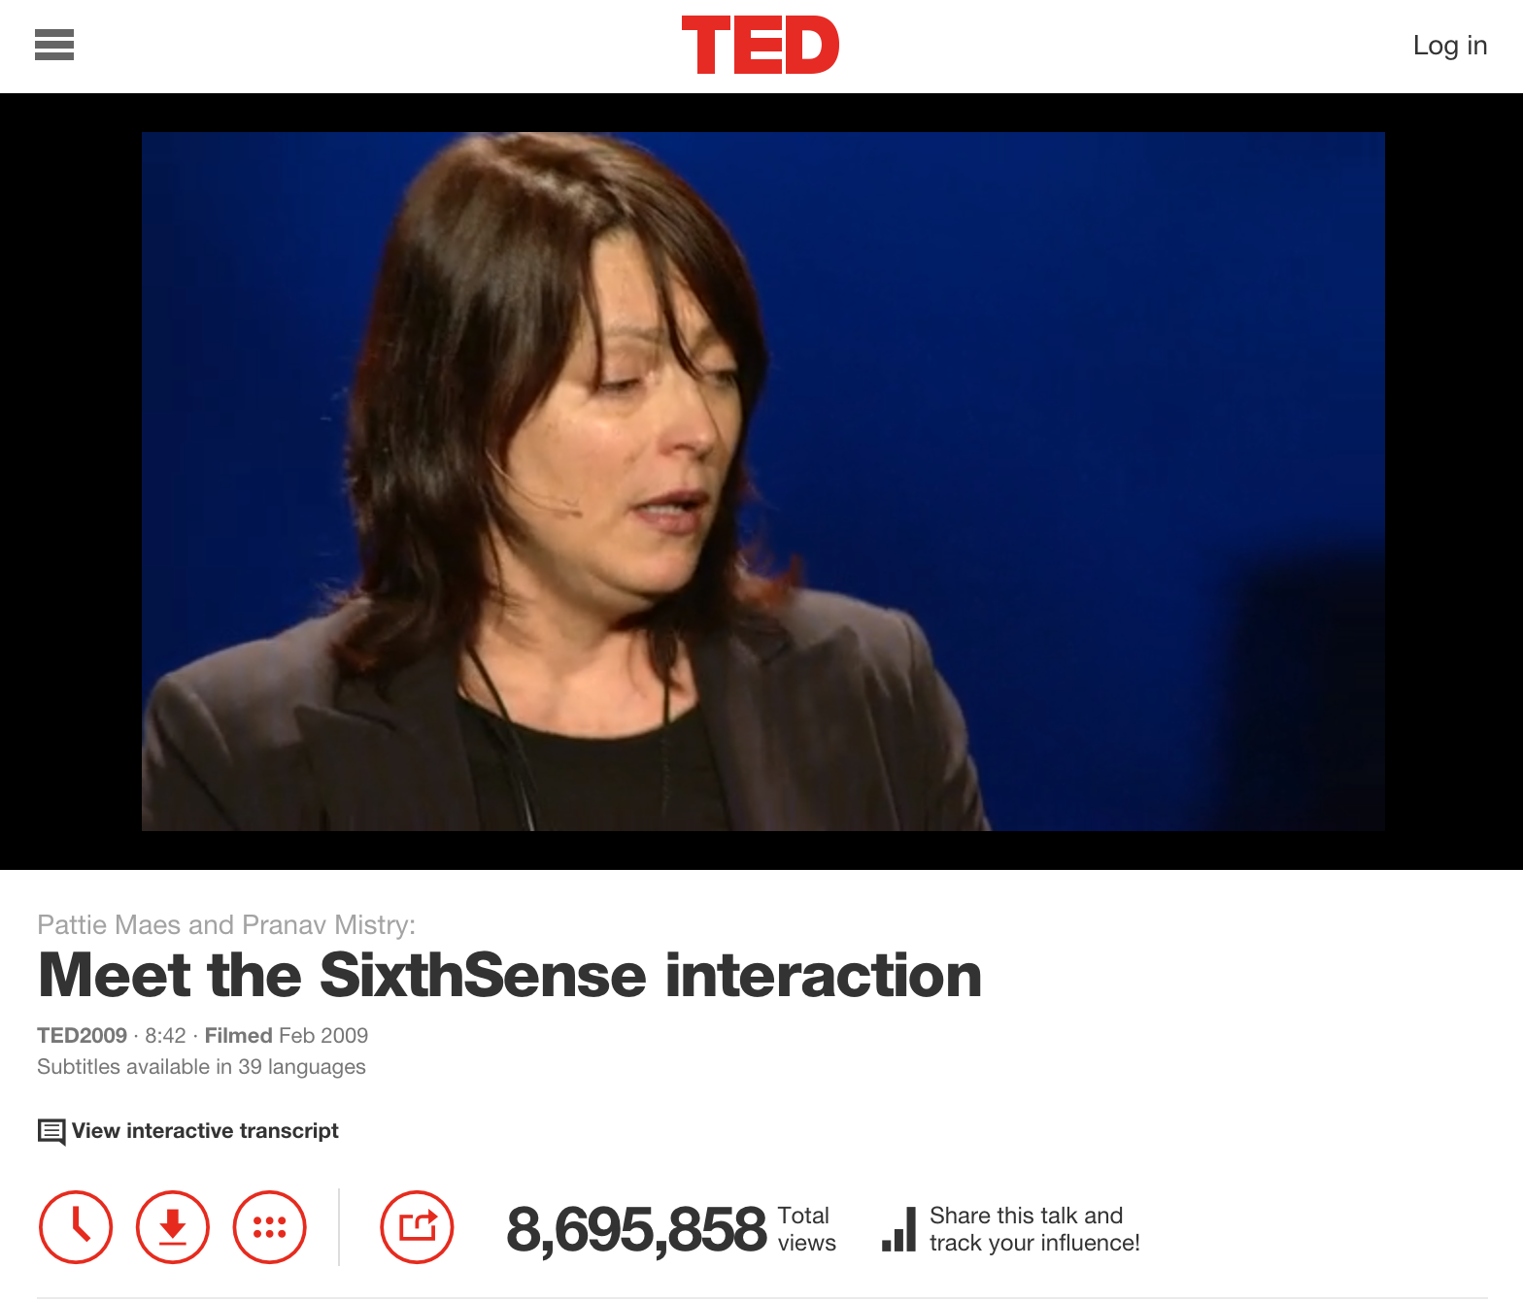
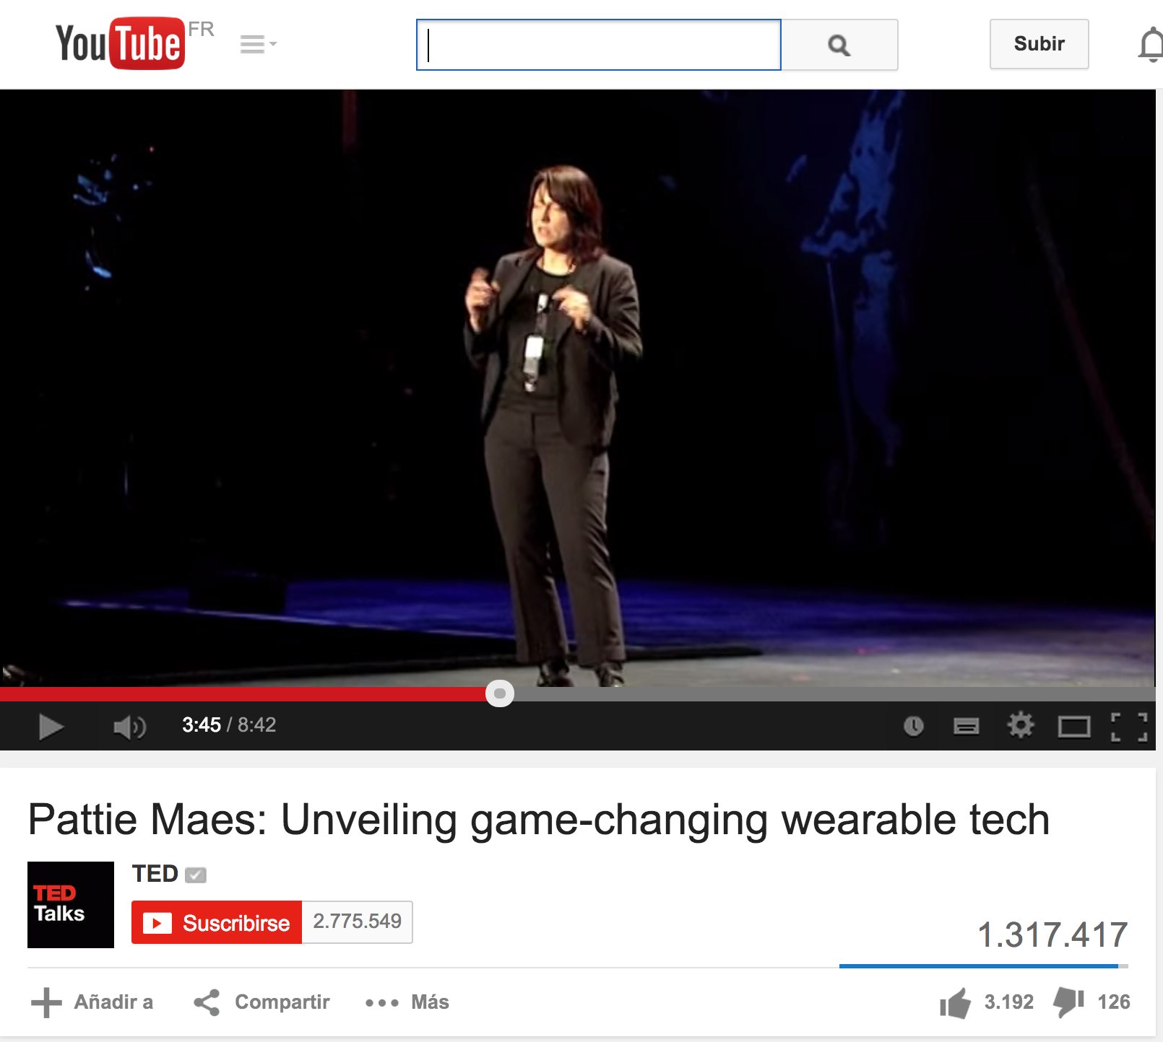
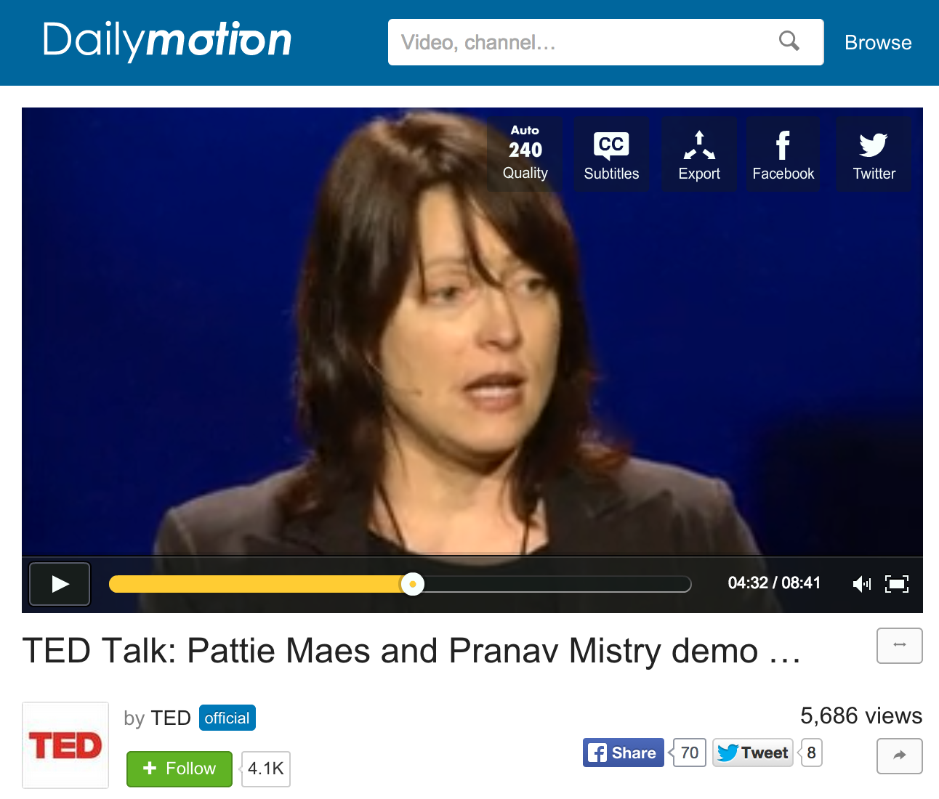


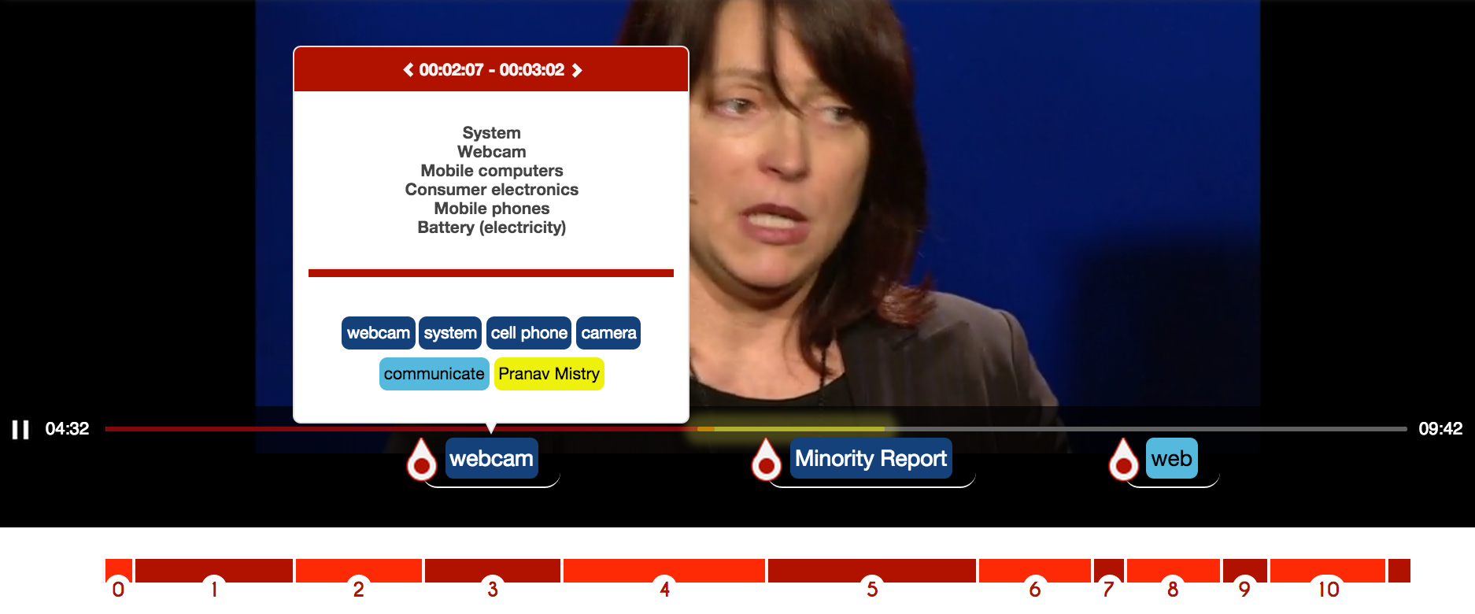

… What is the “SixthSense Interaction”??
111
It is all in this video… But is it worth to be watched?
?
?
?
+ hot spots
Cool, but not my thing. Thanks for saving my time !!!

